Slide 1

EMPLOYMENT IN THE 21ST CENTURY
Presented by
JR Harding, Ed.D. & Katrina Washington
Rick Scott Barbara Palmer
Governor Director

Slide 2



Are You Ready to Challenge Yourself, Your Community and Demonstrate Your Abilities?
Jobs & Promotions
Diversity & Inclusion
Self Advocacy

Slide 3

Real Facts and Real Numbers about the Workforce
National Employment Rates for Persons with Disabilities and Without Disabilities
34.4% of individuals with a disability are working.
75.4% of individuals without a disability are working.
State of Florida Rates for Persons with Disabilities and Without Disabilities
39.1 % of individuals with a disability are working.
77.7% of individuals without a disability are working.
Note: At the national level there was a 41% employment difference between the two groups. At the State of Florida level there was a 43.3% employment difference between the two groups.
Source: Compendium and the Annual American Community Survey (ACS) 2015.

Slide 4


Training Objectives:
Introduction to Agency for Persons with Disabilities
Identifying the Competitive Edge in the 21st Century Workforce
Social Security Work Incentive Benefits
The Employment Enhancement Plan (EEP) Project
Successful 21st Century Employment Outcomes
Making Connections with Business Partners

Slide 5
Mission Statement
The Agency supports persons with developmental disabilities in living, learning, and working in their communities.
Autism
Cerebral Palsy
Spina Bifida
Intellectual disabilities
Down syndrome
Prader-Willi syndrome
Phelan-McDermid syndrome (Effective July 1, 2016)
Children ages 3-5 who are at a high risk of a developmental disability

Slide 6
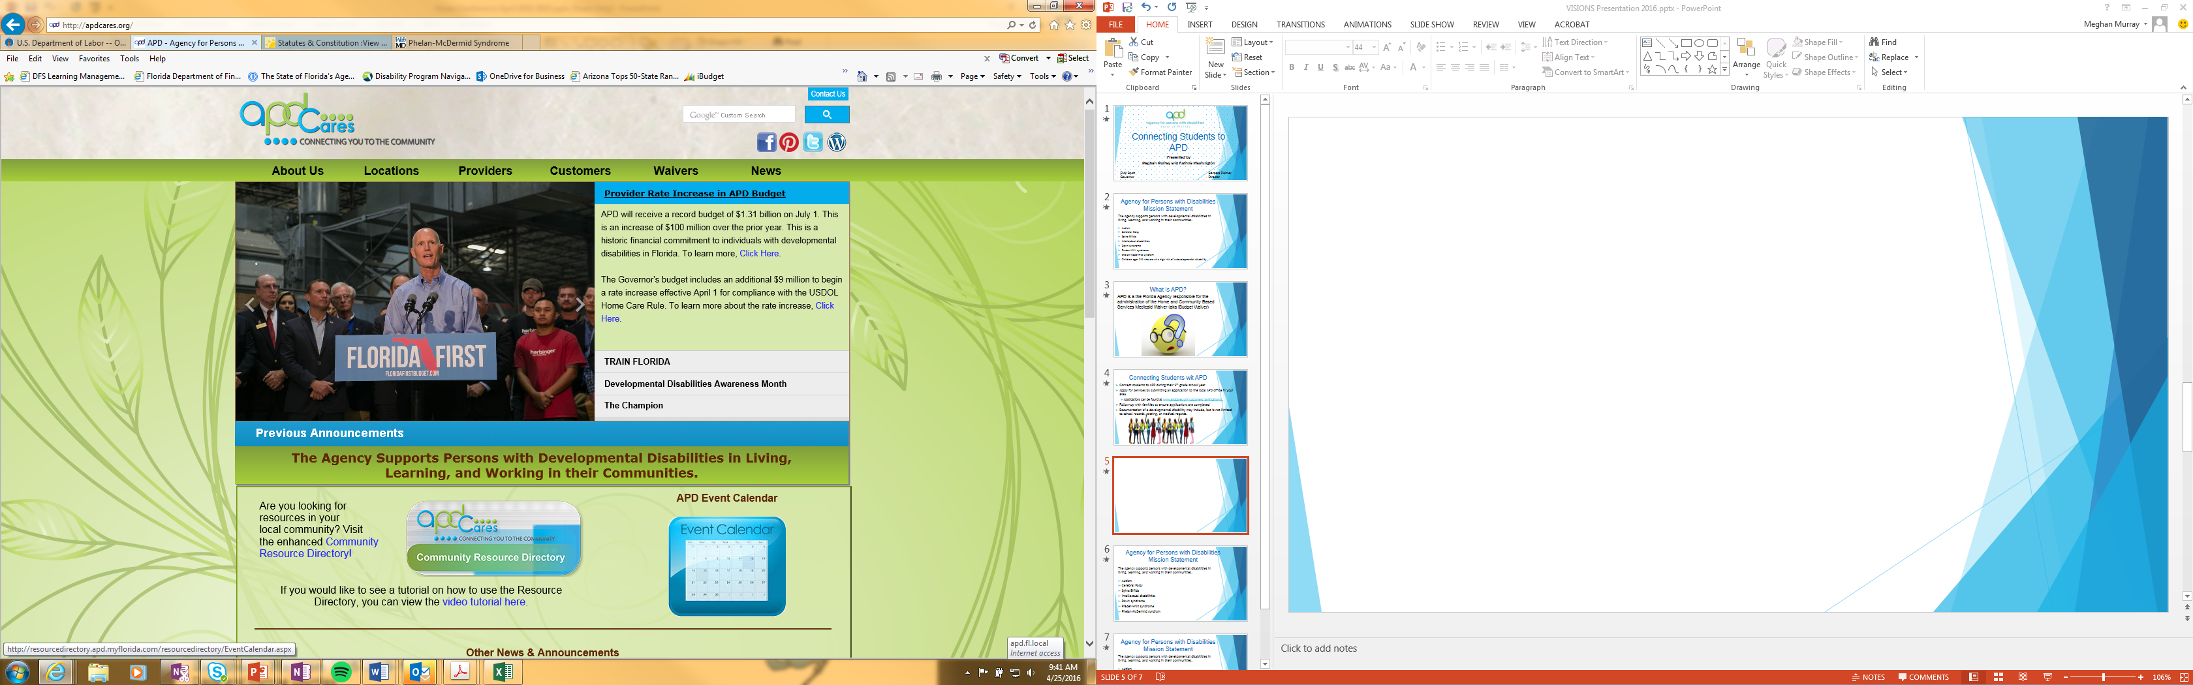

Slide 7

Connecting Individuals with
Developmental Disabilities to APD
Connect individuals to APD as soon as possible.
Apply for services by submitting an online application to the local APD office in your area.
Applications can be found at www.apdcares.org/customers/applications/.
Contact your local APD office for questions and the application process.
Documentation of a developmental disability may include, but is not limited to school records, testing, or medical records.

Slide 8

The Competitive Edge in the 21st Century Workforce
Employers view soft skills as even more important to work readiness for the 21st Century:
Networking – Being able to reach out to people beyond the ones you know. Engaging new employers.
Enthusiasm – Being excited about the job and being able to express why you would be a good employee.
Professionalism – Make sure your resume is dressed to impress and tailored for the job. Dress appropriately for work.
Communications Skills – Learn how and when to share your concerns in the work-place. Self-advocacy is the key.
Teamwork – Successful businesses rely on team-players and those who are able to work independently.

Slide 9
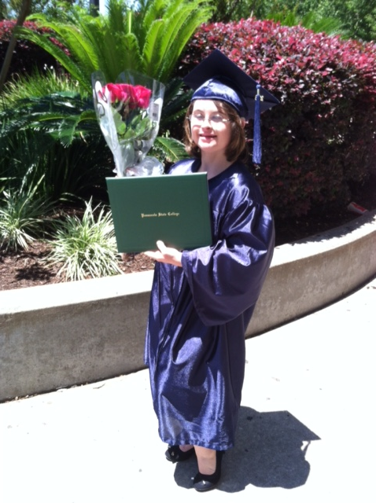
Employment in the 21st Century
This Could Be You
Phillip Cheeseborough
AMC Theatres
Cameron Northrup
Graham Glover
Licensed Esthetician
Publix

Slide 10


21st Century Employers Are Hiring
Are You Ready to Work?
Employers Are Hiring
Are You Ready to Work?
They are desperately in need of hard workers.
There is a shortage of qualified workers.
It’s time to visit diverse industries that we’ve never approached in the workforce, i.e., air conditioning, construction and related trades.
Do you have a resume and a cover letter?
Have you applied for jobs?
Have you practiced interviewing techniques.
Is there a special interviewing outfit? Always dress for success.
Are you networking in your community?
Identify companies that are hiring by attending local Job Fairs.

Slide 11
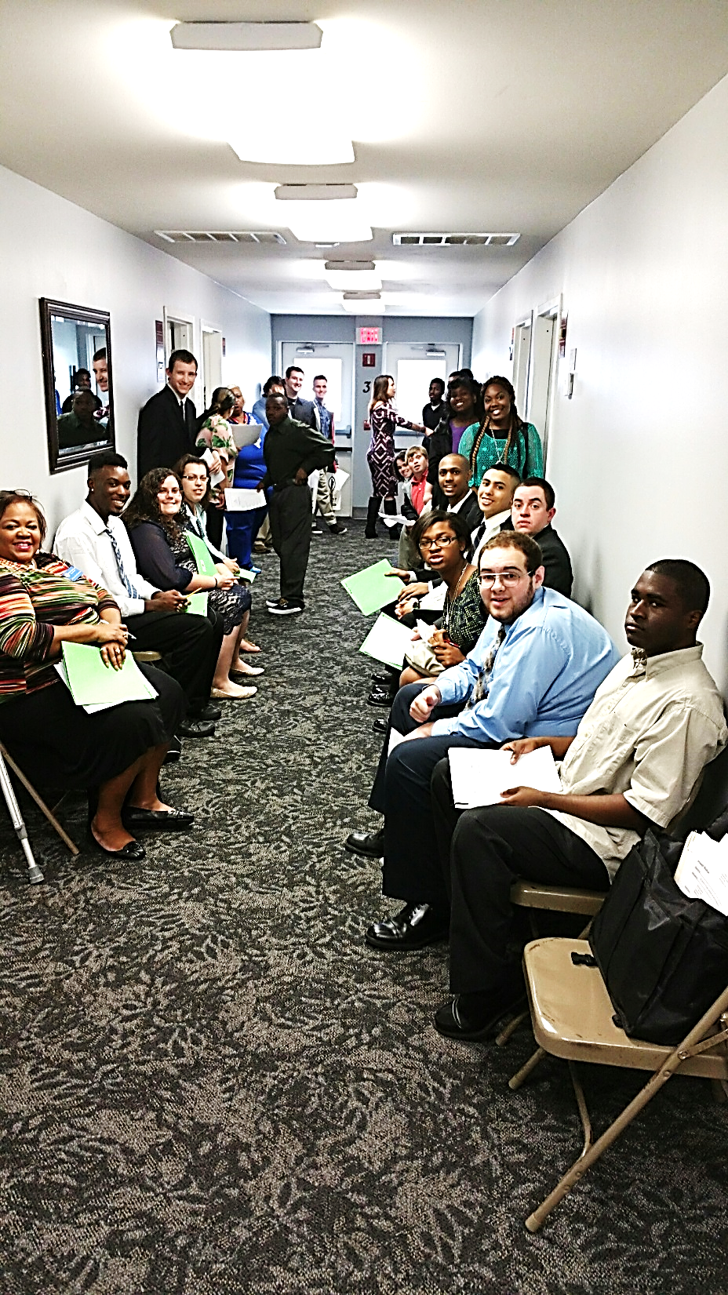
Building Successful Partnerships
Implement Student mock Interview Workshops
Help students attain competitive employment with an income of minimum wage or higher while attending school
Ensure students on the APD Waiting List are connected with a job coach prior to transitioning from high school
Connect schools with employers

Slide 12
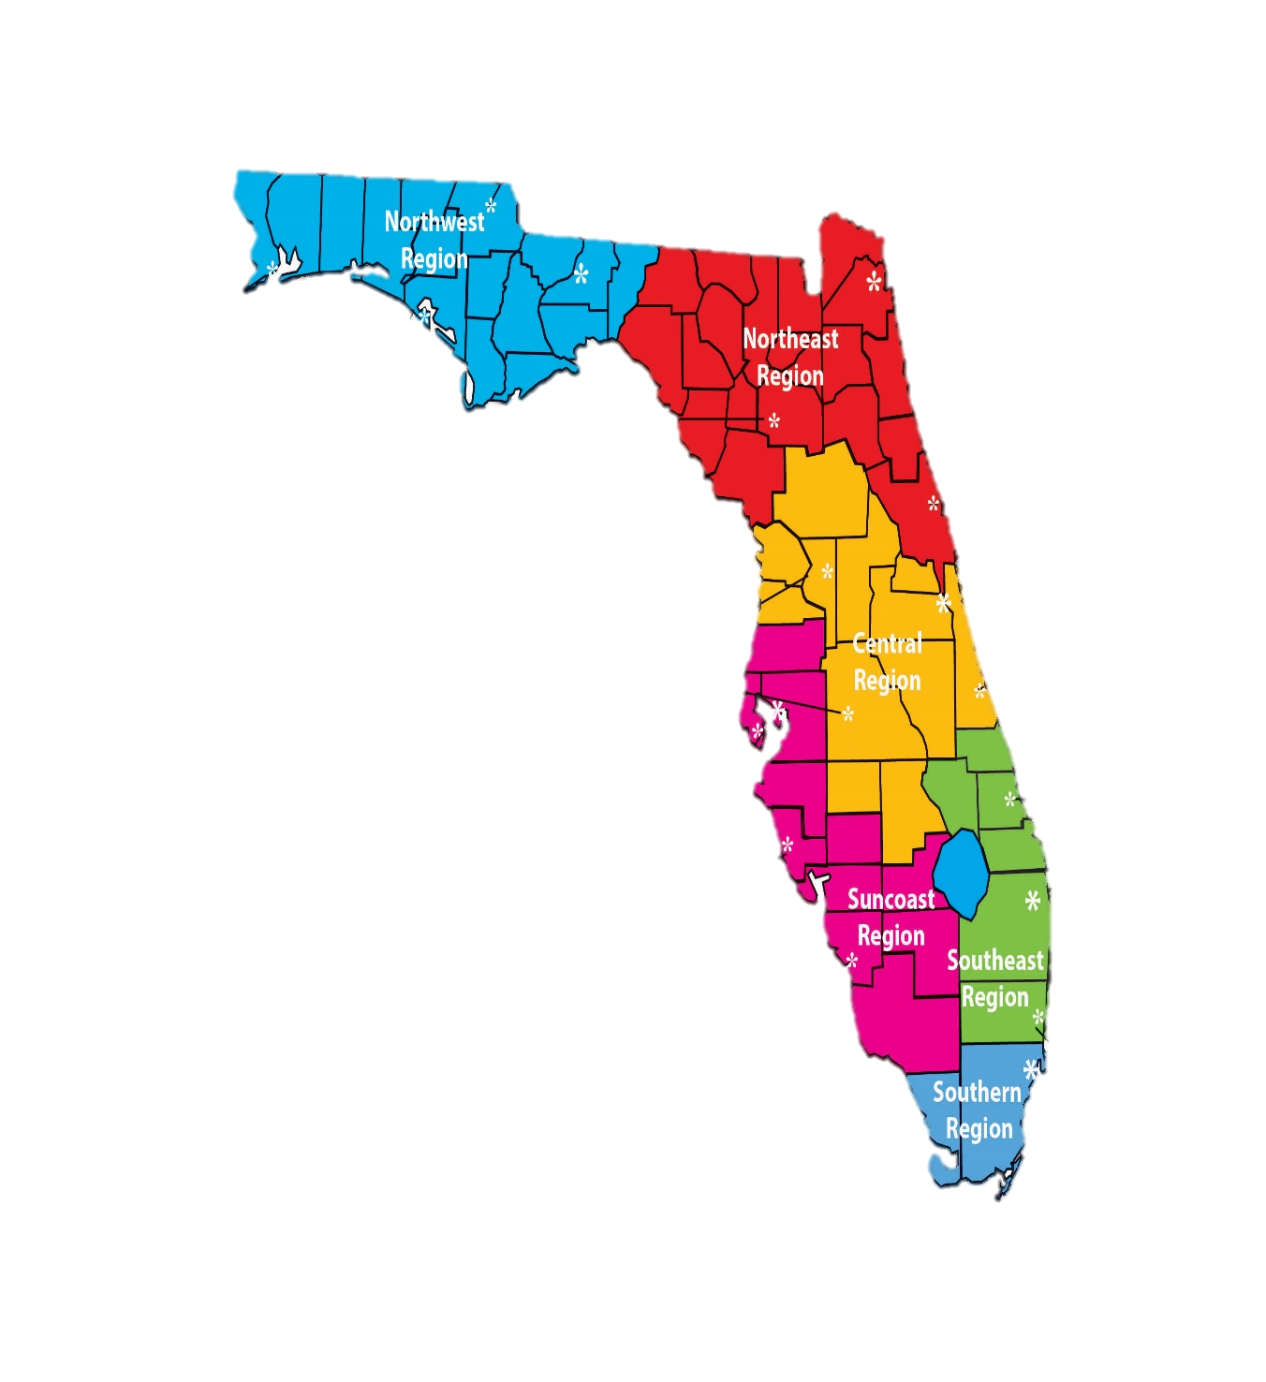


Statewide School Partnerships
APD is working with schools statewide to identify ESE students that are on the APD Waiting List between the ages of 18 to 22.
Schools will need to have parents complete a consent to release form prior to releasing information to APD.
Students (18 and older) will be able to receive supported employment services while attending school.
APD isn’t able to successfully serve students without your assistance

Slide 13

Employment Enhancement Project
EEP
Florida Governor Rick Scott and Florida Legislators have appropriated $1,000,000 to APD for the Fiscal Year(FY) 2015/16 to help APD clients on the Waiting List find and maintain employment and/or internships. APD was appropriated $500,000 for fiscal year 2016 / 2017.
Success Rate: We have 402 positive employment placements and internships.
Job Seekers must be:
At least 18 years old
On the APD Waiting List
Interested in having a Job

Slide 14
Employment Enhancement Project
Highest priority will be for students transitioning from high school to begin working in competitive employment.
Employment Enhancement Project (EEP) funds are non-recurring, with optimistic projections for additional funds for future fiscal years.
Services will be provided by APD Supported Employment Providers.
Services to be funded include:
  Supported Employment Coaching
  Follow- Along Services
  Paid Internships
  Transportation
Participation in EEP does not affect an individual’s Waiting List status. This project is specific to employment.

Slide 15
Maintain Social Security Benefits
Helpful tips for individuals and families with disabilities
Stress the importance of individuals 18 years and older having a shelter obligation.
Individuals will receive the maximum Supplemental Security Income (SSI) benefit amount of $733.00
If students are under the age of 18 and they are not eligible for SSI benefits due to their parent’s income, encourage the student to apply for benefits at the age of 18. The parents income is excluded from a child's SSI benefits at the age of 18.

Slide 16

Students Earned Income Exclusion
SSI ONLY SOCIAL SECURITY WORK INCENTIVE FOR STUDENTS
This provision allows a person who is under age 22 and regularly attending school to exclude earnings from income.
Amount earned that can be excluded is adjusted annually based on increases in the cost-of-living index.
This exclusion applies before any other exclusion
Can carry the balance over to the next month
In January 2016 - $1,780 monthly and up to a yearly maximum of $7,180

Slide 17

Impairment Related Work Expense (IRWE)
SSI and SSDI Work Incentive
Out-of-pocket expenses that support a disability to allow a person to earn income, even if those items or services are also needed for non-work activities can be deducted from the amount of earnings.
EX: Transportation, medication, medical devices, and personal care assistance.
This means, SSI benefits are not reduces as much.

Slide 18
The Able Act
Effective July 1, 2016
Save for the future without losing Supplemental Security Income.
Generally, funds in (or withdrawn from) an ABLE account are disregarded when determining SSI eligibility.
Exceptions:
ABLE funds over $100,000
Housing and non-qualified disability expenses withdrawn but not spent that month
Able Accounts
Save Like Never Before.
A tax-free savings and investment account established to support disability expenses while maintaining government benefits.
A $2,000 asset limit is no longer a barrier
Increase savings through tax-free growth
Receive contributions from family & friends

Slide 19
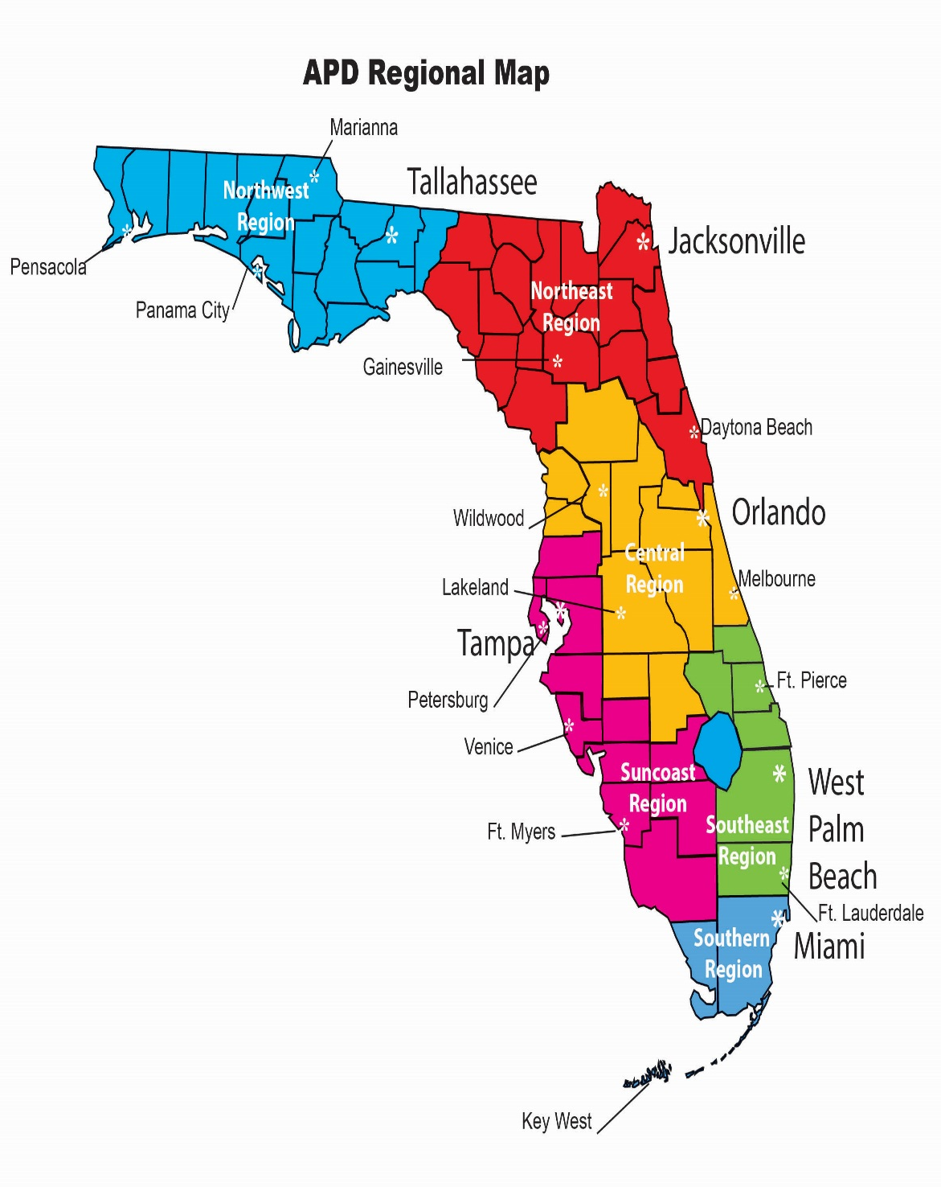
Northwest Region (850) 595-8351
Interim Supported Employment Liaison: Annette Zeeb
Phone: 850-595-8307 Email: Annette.Zeeb@apdcares.org
Counties served: Bay, Calhoun, Escambia, Franklin, Gadsden, Gulf, Holmes, Jackson, Jefferson, Leon, Liberty, Okaloosa, Santa Rosa, Wakulla, Walton, and Washington counties
Northeast Region (904) 992-2440
Supported Employment Liaison: Helen Cooke
Phone: 352-955-6424 Email: Helen.Cooke@apdcares.org
Counties served: Alachua, Baker, Clay, Columbia, Dixie, Duval, Flagler, Gilchrist, Hamilton, Lafayette, Levy, Madison, Nassau, Putnam, St. Johns, Suwannee, Taylor, Union, and Volusia counties.
Central Region (407) 245-0440
Supported Employment Liaison: Mollie Brown-Ferrier
Phone: 863-413-3377 Email: Mollie.Brown-Ferrier@apdcares.org
Supported Employment Liaison: Earl Solano
Phone: 407-245-0440 Email: Earl.Solano@apdcares.org
Supported Employment Liaison: Elizabeth Watson
Phone: 352-330-2739 Email: Elizabeth.Watson@apdcares.org
Counties served: Brevard, Citrus, Hardee, Hernando, Highlands, Lake, Marion, Orange, Osceola, Polk, Seminole, and Sumter counties
Suncoast Region (812) 233-4300
Supported Employment Liaison: Debra Noel
Phone: 813-233-4449 Email: Debra.Noel@apdcares.org
Supported Employment Liaison: Jim Vidrine
Phone: 239-338-1378 Email: James.Vidrine@apdcares.org
Counties served: Charlotte, Collier, DeSoto, Glades, Hendry, Hillsborough, Lee, Manatee, Pasco, Pinellas, and Sarasota counties
Southeast Region (561) 837-5564
Interim Supported Employment Liaison: Rita Castor (Deputy Regional Operations Manager)
Phone: 561-568-0795 Email: Rita.Castor@apdcares.org
Supported Employment Liaison: Milory Senat
Phone: 561-398-2240 Email: Milory.Senat@apdcares.org
Counties served: Broward, Indian River, Martin, Okeechobee, Palm Beach and St. Lucie counties
Southern Region (305) 349-1478
Supported Employment Liaison: Michelle Alamo
Phone: 305-349--1299 Email: Michelle.Alamo@apdcares.org
Supported Employment Specialist: Michael Cardello
Phone: 305-808-6236 Email: Michael.Cardellow@apdcares.org
Counties served: Dade and Monroe counties

Slide 20
Resources
The Able Trust – www.abletrust.org
Agency for Persons with Disabilities - www.apdcares.org
CareerSource Florida - www.careersourceflorida.com
Disability Resources – www.disability.gov
Disability Scoop - www.disabilityscoop.org
Employment Websites:
www.indeed.com
www.employflorida.com
Florida Commission for Transportation Disadvantaged - www.dot.state.fl.us/CTD/
Florida Developmental Disabilities Council - www.fddc.org/
Jobs Accommodation Network – www.askjan.org
National Disability Institute (NDI) - www.realeconomicimpact.org
Social Security Administration - www.ssa.gov
Vocational Rehabilitation - www.rehabworks.org

Slide 21
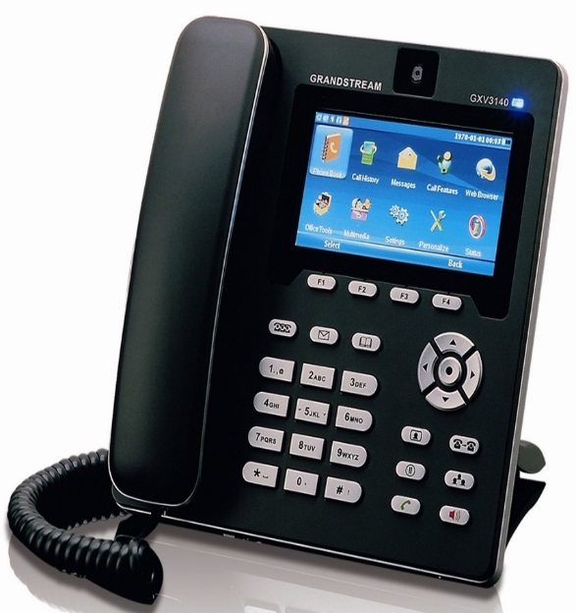
Contact Information
JR Harding, Ed.D.
Agency for Persons with Disabilities
State Office Community Supports
4030 Esplanade Way, Suite 380 Q, Tallahassee, FL 32399
Office: 850-922-5220/Cell: 850-510-4628
Email: JR.Harding@apdcares.org
Katrina Washington
Agency for Persons with Disabilities
State Office Community Supports & Supported Employment
160 Government Street, Suite 412, Pensacola, FL 32502
Office: 850-595-8329/Cell: 850-556-5859
Email: Katrina.Washington@apdcares.org

Slide 22

Thank You!

